Slide 1
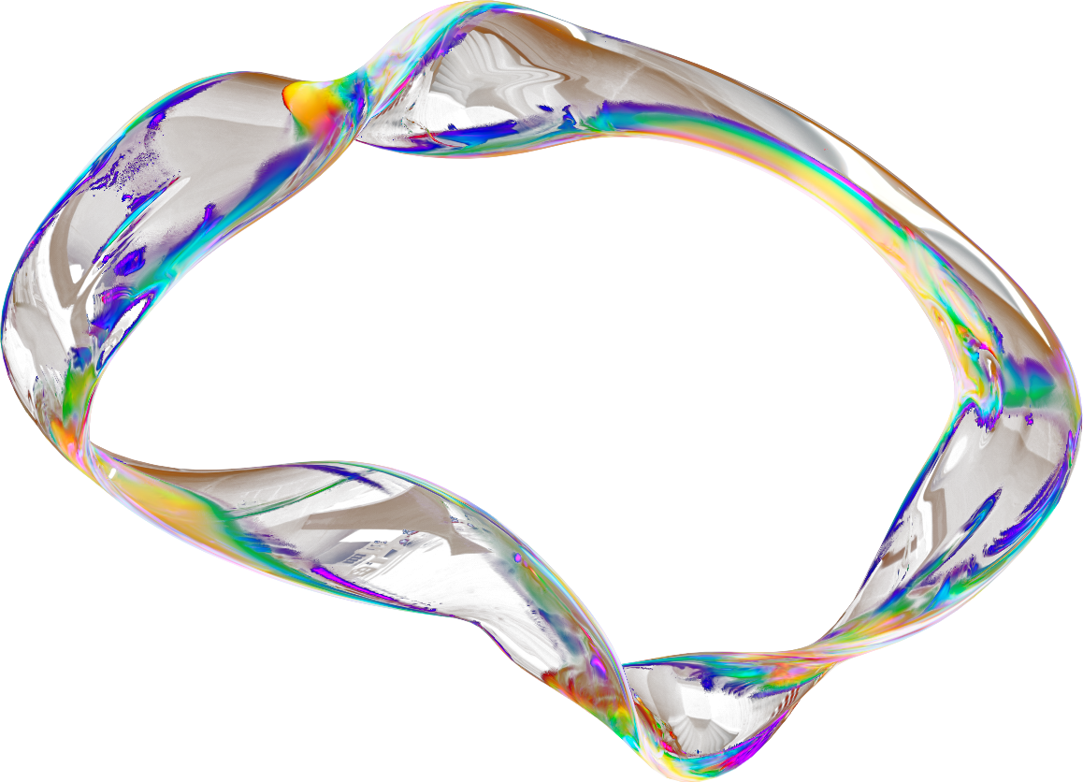
INTELLECTUAL PROPERTY (IP)
A BREIF CONTEXT AND APPLICABLE EU LAWS
Present by Lawrence C. Obi

Slide 2


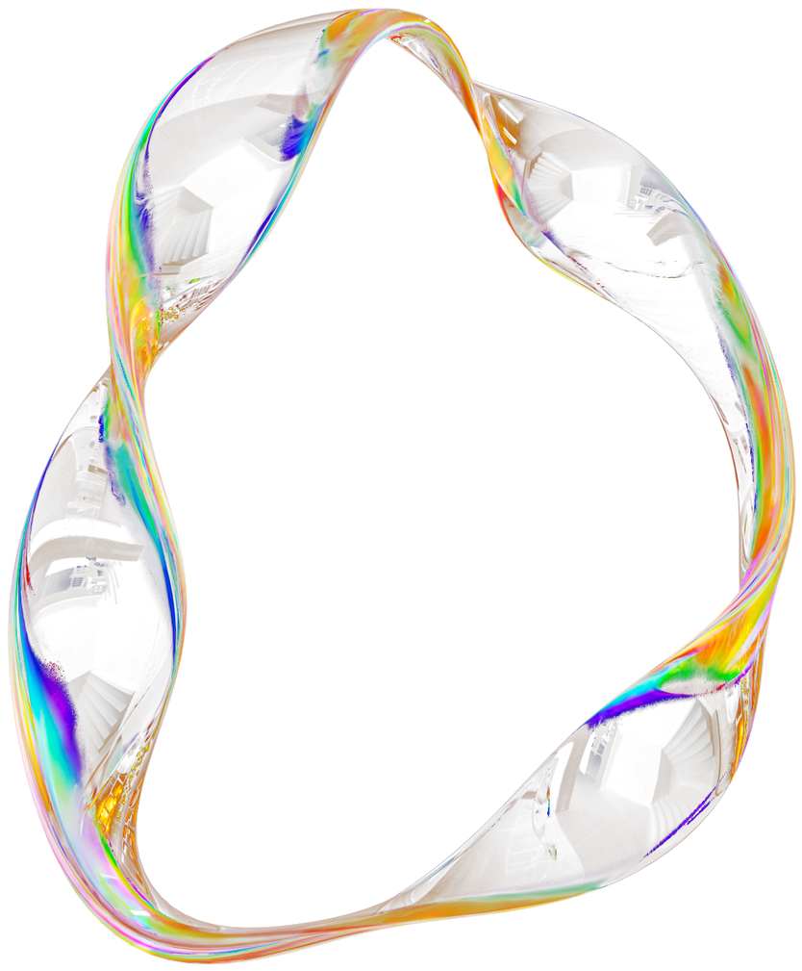
DISCUSSION & AGENDA
1
Introduction
6
Challenges and Considerations
2
Key concepts
7
IP Infringement
3
Types of Intellectual Property
8
Case Study: Apple vs. Samsung
4
Importance of Intellectual Property Protection
9
Best Practices for IP Management
5
Intellectual Property Laws in the EU and International Treaties
10
Conclusion / Q&A

Slide 3
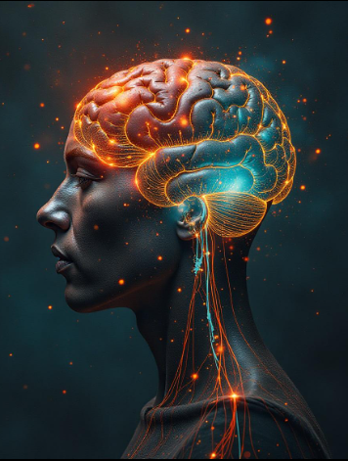
INTRODUCTION
Intellectual property (IP) refers to creations of the mind like inventions, literary works, artistic works, designs, symbols, and names used in commerce.
It includes inventions, artistic works, industrial designs, trademarks, and trade secrets. IP protection ensures that creators and innovators can benefit from their work, encouraging innovation and economic growth.
IP theft can result in significant economic loss and competitive disadvantage.
Protection involves rights management, strict access controls, and potentially watermarking or other methods to trace and identify unauthorized copies

Slide 4


KEY CONCEPTS
ORIGINALITY
CREATIVITY
The work must be the product of the author's own intellectual effort.
The work must involve a degree of creative thought.
FIXATION
INFRINGEMENT
The work must be expressed in a tangible form.
Unauthorized use or exploitation of Intellectual Property

Slide 5
COPYRIGHT
TRADEMARK
PATENT
TYPES OF INTELLECTUAL PROPTERY
TRADE SECRET
DESIGN RIGHT

Slide 6

COPYRIGHT
Copyright law grants protections against unauthorized duplications of an original creative work.
Protects original works of authorship, including literature, music, art, and software. E.g: J.K. Rowling's Harry Potter series
Authors can control how their work is distributed, reproduced, and used.
Protection
70 years after the death of the last remaining author of the work, unless it’s “work for hire”.
Works for hire and anonymous works are protected 95 years from the date of first publication or 120 years from the date of creation, whichever is shorter
Penalties: Up to $1,000,000 in damages and ten years in prison for repeat offenders

Slide 7
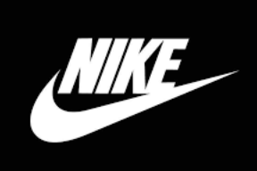
TRADEMARK
A trademark protects words, brand names ,symbols, sounds, shapes, colors, musical tones, or combinations used to identify products to distinguish them from others.
The primary purpose is to avoid confusion in the marketplace
Eg. Netflix Sound Intro, Nike Swoosh
Protection
Protect from someone stealing another company’s “look and feel”
While registration is not mandatory, it provides significant benefits, including nationwide protection and the ability to sue for infringement. This occurs when someone uses a trademark that is confusingly similar to another.
Granted for an initial period of 10 years and can be renewed an unlimited number of times for another 10 years

Slide 8
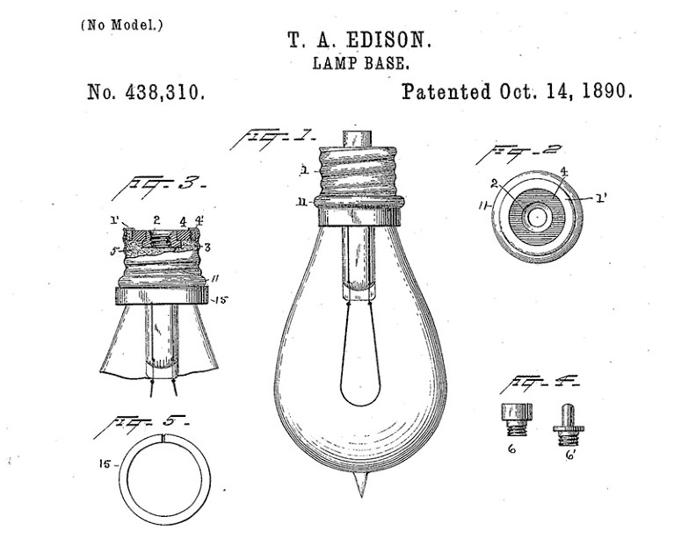
PATENT
Patents protect the rights of inventors and their inventions.
Types: Utility patents protect inventions, design patents protect the ornamental appearance of a product, and plant patents protect new and distinct plant varieties.
Eg: The electric lamp was invented by Thomas Edison, patented in 1880, and lamp base in 1890.
Protection: for those who have legal ownership of the patent
Patent Requirements:
Invention must be new
Invention must be useful
Invention must NOT be obvious
Owner has exclusive control of the invention for 20 years - after which the invention enters the public domain.

Slide 9
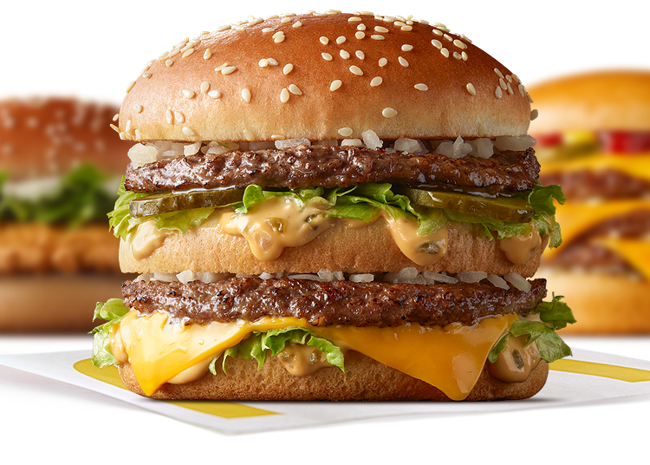
TRADE SECRETS
Confidential business information that provides a competitive advantage.
To qualify as a trade secret, information must be valuable, secret, and have measures in place to protect its secrecy.
Examples: The McDonald's burger recipe.
Rights: No exclusive rights, but protection against misappropriation and unlawful acquisition
Economic Espionage Act of 1996: Anyone found guilty of stealing trade secrets.
From US corporation - Fined up to $500,000 and 15 years
Under other circumstances - Fined up to $250,000 and 10 years
Nondisclosure agreements (NDA) should be used to prohibit the sharing of trade secrets.

Slide 10
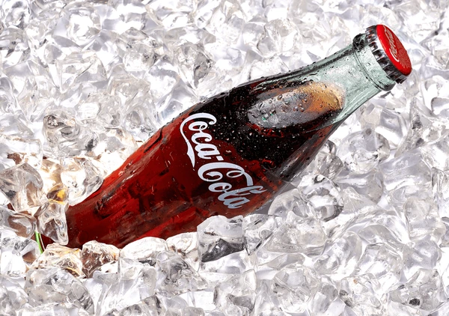
DESIGN RIGHTS
Protect the visual design of products that are new and have individual character.
Example: The unique design of the Coca-Cola bottle is protected by design rights.
Exclusive rights: to use the design and prevent others from using it in a confusingly similar way.
Duration: Design rights are typically time-limited. Depending on the jurisdiction, these rights can last for 10-25 years

Slide 11
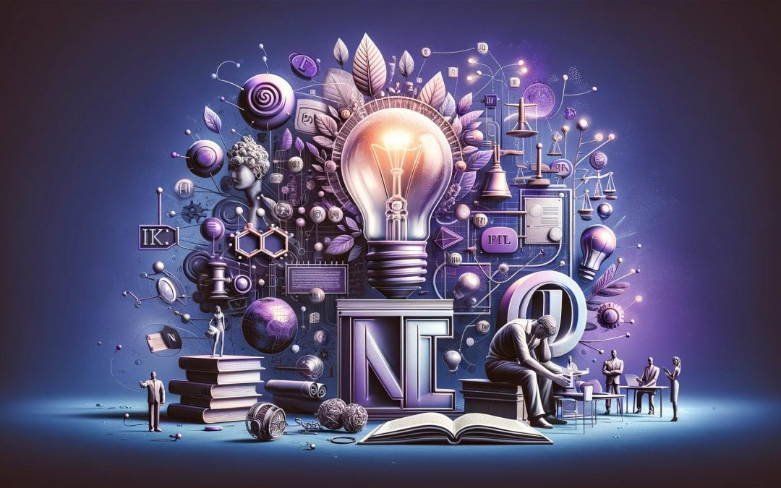
IMPORTANCE OF INTELLECTUAL PROPERTY PROTECTION
Encourages Innovation
Stimulates Economic Growth
Protects Jobs
Prevents Unfair Competition

Slide 12
INTELLECTUAL PROPERTY LAWS IN THE EU
INTERNATIONAL TREATIES
Copyright Directive (2001/29/EC):
Protects authors and other creators of literary, artistic, and scientific works, including software, music, and films.
Trademarks Directive (2008/95/EC):
Harmonizes trademark law across EU member states, protecting brand names, logos, and other distinctive signs.
Patent Regulation (Regulation (EU) No 2017/1001):
Establishes a unitary patent system within the EU, simplifying the process of obtaining and enforcing patents.
Design Directive (2003/87/EC):
Protects the appearance of products, such as industrial designs and the ornamental aspects of products.
TRIPS Agreement:
Establishes minimum standards for IP rights globally, influencing national legislation.
Paris Convention:
Protects industrial property (patents and trademarks) and promotes international cooperation.
Berne Convention:
Safeguards literary and artistic works, ensuring authors' rights are respected globally.

Slide 13
CHALLENGES AND CONSIDERATIONS
Enforcement
Global Challenges
Balancing Rights
Technological Advancements
Ensuring effective enforcement of IP rights can be challenging, especially in the digital age where the copying of content is easier than ever.
Protecting IP in a globalized world requires international cooperation and agreements, to address complexities in cross-border trade.
IP protection must be balanced with other rights, such as freedom of expression and fair competition while ensuring public access to information and cultural works.
New technologies, such as artificial intelligence and blockchain, raise new challenges and opportunities for IP protection.

Slide 14

IP INFRINGEMENT
Violation of an intellectual property right
Remedies
Enforcement Directive (2004/48/EC)
In cases of IP infringement, the owner may seek damages, injunctions, and attorneys' fees.
Provides procedures and remedies for effective enforcement of IP rights, allowing rights holders to take action against infringements.
International Protection
Customs Regulation
International treaties and agreements, such as the Berne Convention and the Paris Convention, provide for the protection of IP rights in multiple countries
Empowers customs authorities to act against counterfeit goods at borders, protecting both consumers and IP owners.

Slide 15
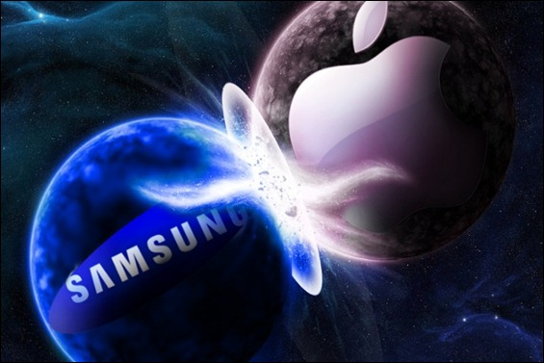
CASE STUDY:
APPLE VS. SAMSUNG
Background: Apple filed a lawsuit against Samsung in 2011, claiming that Samsung had infringed on several of its patents related to smartphone technology and design.
Outcome: The case highlighted the importance of design patents, leading to a significant ruling in favor of Apple. Samsung was ordered to pay damages for infringement.
Implications: This case underscored the value of IP protection in the tech industry and prompted companies to invest heavily in securing their innovations.

Slide 16
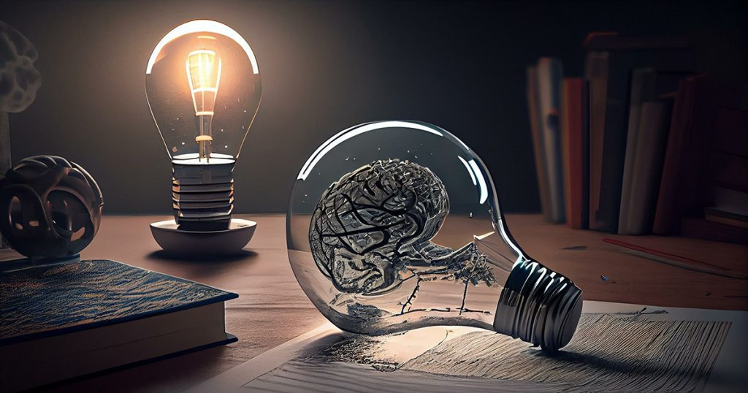
BEST PRACTICES FOR
IP MANAGEMENT
Ensure that patents, trademarks, and designs are registered to provide legal protection.
Actively monitor for potential infringements and be prepared to take action.
Foster a culture of respect for IP rights through training and awareness programs.
Work with IP attorneys to develop effective strategies for protecting and enforcing IP rights.
Register IP Rights
Monitor and Enforce
Educate Employees
Consult Legal Experts

Slide 17
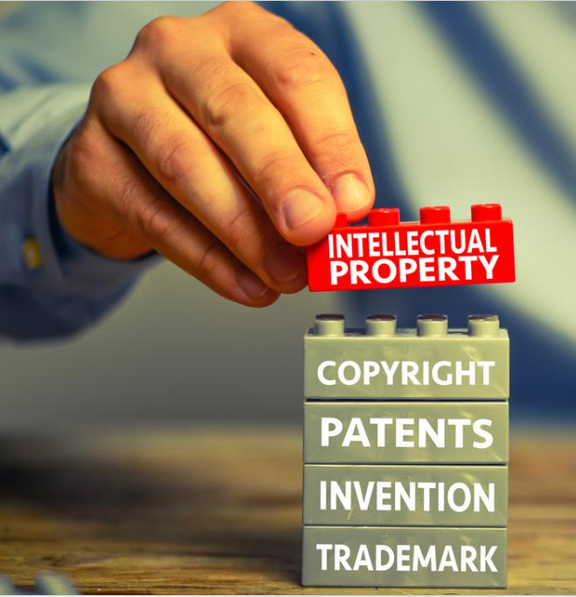
CONCLUSION
Intellectual Property laws in the EU are essential for fostering innovation and economic growth. The EU's harmonized approach provides a solid foundation for protecting IP rights across member states, while ongoing adaptations will be necessary to meet future challenges.

Slide 18
Q&A
THANK YOU
for your time and attention
Present by Lawrence C. Obi

